Slide 1
A MINI PROJECT
On
REAL-TIME LANE DETECTION AND PATH PREDICTION FOR AUTONOMOUS VEHICLES USING DEEP LEARNING TECHNIQUES(PRC-0)
BACHELOR OF TECHNOLOGY
IN
CSE- AI & ML
21VE1A6633 KYASANI SRIJA
21VE1A6634 MANNEPALLI BHANU TEJA
21VE1A6637 METTU RUTHVIK ROSHAN
21VE1A6642 PATEL VARUN REDDY
Under the Guidance of
Mr. P. Srinivas Rao
Assistant Professor
ACADEMIC YEAR: (2024-2025)

Slide 2
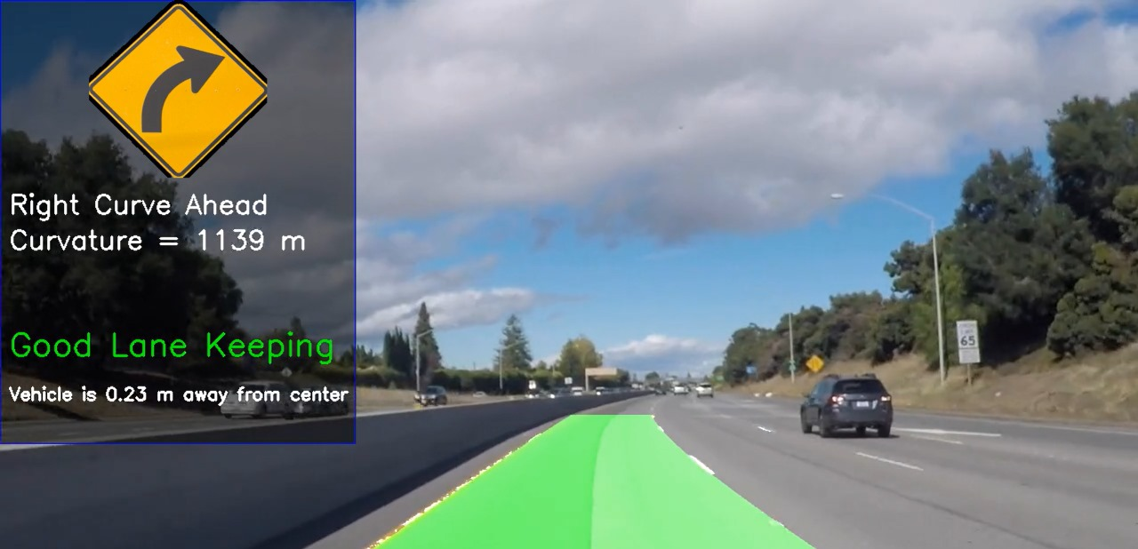
REAL-TIME LANE DETECTION AND PATH PREDICTION FOR AUTONOMOUS VEHICLES USING DEEP LEARNING TECHNIQUES
CONTENTS
Abstract
Problem Statement
Existing System
Proposed System
Software and Hardware
requirements
References
Queries

Slide 3
ABSTRACT
This project focuses on improving lane detection and path prediction for self-driving cars using advanced deep learning methods. Accurately detecting lane markings is crucial for safe driving, but this can be difficult in different conditions like bad weather, low light, faded lanes, or unclear road signs. Additionally, predicting where the car should go next is essential for navigating safely in changing traffic situations. Our approach aims to tackle these challenges by using a deep learning model that combines U-Nets to detect lane markings and Long-Short Term Memory’s to predict the vehicle’s future trajectory. The model will be trained on a diverse dataset, covering various weather conditions, road types, and traffic patterns to improve its generalization across different real-world scenarios. The ultimate goal is to enhance the safety and reliability of self-driving cars, enabling them to operate smoothly, avoid potential hazards, and navigate confidently in everyday traffic environments.

Slide 4
PROBLEM STATEMENT
Autonomous vehicles are designed to drive themselves, but they face many challenges. One major challenge is accurately detecting lane markings on the road. Lane markings can be hard to see in different conditions. If the vehicle cannot correctly identify the lanes, it may steer incorrectly, which can lead to dangerous situations.Another challenge is predicting where the vehicle should go next.To overcome the above challenges we introduce GAN-UNet Architecture which employs Generative Adversarial Networks(GANs) for Lane Detection and LSTM with Data Augmentation in for path prediction.

Slide 5
EXISTING SYSTEM
Recent advancements in deep learning have improved lane detection and path prediction systems in autonomous driving.
These systems leverage large datasets and powerful neural networks to enhance accuracy.
They can identify lane markings and predict vehicle trajectories, facilitating real-time driving decisions.
This progress is essential for improving vehicle safety and making autonomous driving a more feasible reality.
One of the existing system is Waymo’s Self-Driving Technology .

Slide 6
DISADVANTAGES
Data Dependency: Most deep learning models require large amounts of labeled data for training, which can be difficult and costly to acquire.
Generalization Issues: Models trained in specific environments may not perform well in different geographical locations or under different weather conditions.
Computationally Intensive: Deep learning models need a lot of computing power, which can make them difficult to use for real-time applications on low-power devices.
Sensitivity to Conditions: Many systems struggle with adverse weather conditions (e.g., rain, snow) and complex driving scenarios (e.g., construction zones).
Safety and Reliability: Ensuring safety and reliability in real-world applications remains a challenge, particularly for fully autonomous systems.

Slide 7
PROPOSED SYSTEM
In this system, we combine UNet and Generative Adversarial Networks (GANs) to improve lane detection by generating more realistic and accurate lane segmentation masks.
By combining the segmentation capabilities of UNet with the adversarial learning of GANs, this system improves lane detection by ensuring high-quality, realistic, and detailed segmentation masks that are crucial for safe autonomous driving.
We use data augmentation with LSTM networks to significantly enhance their performance by providing a richer and more diverse training dataset.

Slide 8
ADVANTAGES
.
Better Handling of Complex Structures: U-Nets combined with GANs can generate realistic outputs with coherent structures, enhancing pattern recognition in images.
Enhanced Performance in Image Segmentation: U-Nets provide sharper, pixel-level segmentations while GANs refine overall image quality, leading to more accurate results.
Better Performance on Sequential Tasks: LSTMs trained with augmented data achieve improved accuracy resulting in more reliable predictions.
Efficient Use of Limited Data: Expands the dataset without the need for additional data collection.

Slide 9
SOFTWARE AND HARDWARE REQUIREMENTS
SOFTWARE | HARDWARE
Programming Language: Python 3.11.5 | CPU: Intel i7/i9
Environment : VSCode | RAM: 16 GB
Operating Systems: Windows | Cloud Solution : Google Colab

Slide 10
REFERENCES
1.Der-Hau Lee and Jinn-Liang Liu: End-to-end Deep Learning of Lane detection and path prediction for Real time
Autonomous Driving .arXiv:2102.04738v2 (2023).
2.Lee, D.H., Liu, J.L.: End-to-end multi-task deep learning and model based control algorithm for autonomous driving
arXiv:2112.08967 (2021)
3.Yoo, Seokju, Hee Seok Lee, and Kyomin Jung. "End-to-end lane marker detection via dynamic vision." Proceedings of
the IEEE/CVF International Conference on Computer Vision (ICCV) (2021): 361-370.
4.Garnett, N., et al.: 3D-LaneNet: end-to-end 3D multiple lane detection. In: Proceedings of IEEE International
Conference on Computer Vision, pp. 2921–2930 (2019) .
5.Kim, W., et al.: Vehicle path prediction using yaw acceleration for adaptive cruise control. IEEE Trans. Intell. Transp.
Syst. 19, 3818–3829 (2018)

Slide 11
6. Liu, Zhenyu, Xianzheng Yin, and Kaiqi Huang. "BeziérLaneNet: Detection of Lanes as Beziér Curves." IEEE
Transactions on Intelligent Transportation Systems 22, no. 11 (2021): 7336-746.
7. Kreiss, Sven, Lorenzo Bertoni, and Alexandre Alahi. "PifPaf: Composite fields for human pose estimation."
Proceedings of the IEEE/CVF Conference on Computer Vision and Pattern Recognition (2019): 11977-11986.
8. Chen, Wenjie, Wei Tian, Yu-Kun Lai, Sheng Jin, and Shaojie Shen. "Lane-aware object detection for autonomous
driving." IEEE Transactions on Intelligent Transportation Systems 23, no. 5 (2022): 4713-4727.
9. Neven, Davy, Bert De Brabandere, Stamatios Georgoulis, Marc Proesmans, and Luc Van Gool. "Towards end-to
end lane detection: An instance segmentation approach." IEEE Intelligent Vehicles Symposium (IV) (2018): 286-291.

Slide 12

QUERIES ??

Slide 13
Thank
You!!

